Slide 1
Flexbox: What’s next
11
I399 Web Development

Slide 2
Flexbox
“The CSS3 Flexible Box, or flexbox, is a layout mode providing for the arrangement of elements on a page such that the elements behave predictably when the page layout must accommodate different screen sizes and different display devices. For many applications, the flexible box model provides an improvement over the block model in that it does not use floats, nor do the flex container's margins collapse with the margins of its contents.”
https://developer.mozilla.org/en-US/docs/Web/CSS/CSS_Flexible_Box_Layout/Using_CSS_flexible_boxes

Slide 3
Documentation
https://developer.mozilla.org/en-US/docs/Web/CSS/CSS_Flexible_Box_Layout/Using_CSS_flexible_boxes (recommended)
https://scotch.io/tutorials/a-visual-guide-to-css3-flexbox-properties
https://css-tricks.com/snippets/css/a-guide-to-flexbox/

Slide 4
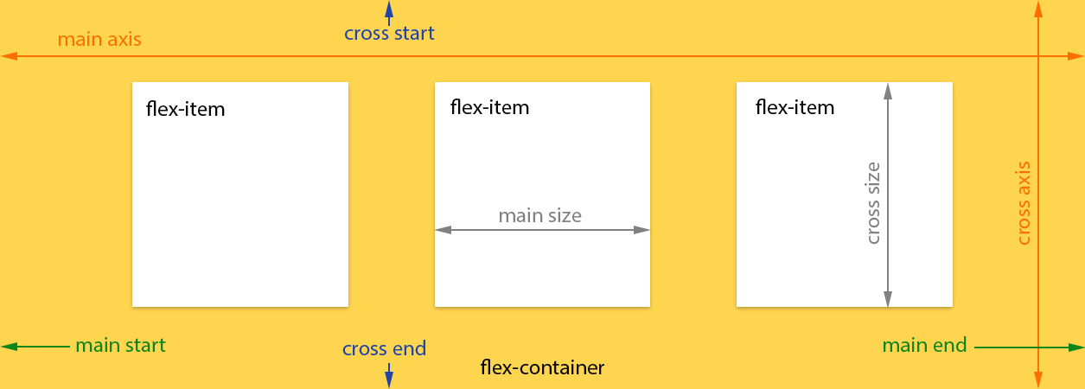
Flex-container
Flex-item

Slide 5
Flexbox Example
.flex-container
.flex-container {
display: flex;
flex-flow: row wrap;
}
.flex-items {
width: 200px;
height: 250px;
background-color: orange;
flex: 0 1 auto; /* default */
}
.flex-items
.flex-items

Slide 6
Flexbox Container
.flex-container {
display: flex | inline-flex;
flex-flow: <flex-direction> <flex-wrap>; /* Shorthand, preferred method */
flex-direction: row | row-reverse | column | column-reverse;
flex-wrap: nowrap | wrap | wrap-reverse;
* justify-content - use when horizontal row, how items align along main axis */
justify-content: flex-start | flex-end | center | space-between | space-around;
* align-items - use when horizontal row, how items align on cross axis */
align-items: flex-start | flex-end | center | stretch | baseline;
/* align-content - use when more than one row, i.e. when content wraps */ align-content: flex-start | flex-end | center | stretch | space-between | space-around;
}

Slide 7
Flexbox Items
.flex-items {
flex-grow: <integer>; /* Defaults to 0 */
flex-shrink: <integer>; /* Defaults to 1, negatives NOT ok */
flex-basis: <length> | auto; /* Lengths in %, em or px */
flex: <flex-grow> <flex-shrink> <flex-basis>; /* Default = 0 1 auto */
/* Overrides vertical alignment for one or more items */ align-self: auto | flex-start | flex-end | center | stretch | baseline;
/* A whole number, negatives ok */
order: <integer>;
}

Slide 8
More resources
Tutorial - online http://flexboxin5.com/ http://www.sketchingwithcss.com/samplechapter/cheatsheet.html
Can I Use? http://caniuse.com/#feat=flexbox
In-depth article https://www.smashingmagazine.com/2015/08/flexible-future-for-web-design-with-flexbox/
Flexbox Generator http://the-echoplex.net/flexyboxes/

Slide 9

Let’s play a game!
Open Flexbox Froggy and follow the directions.
http://flexboxfroggy.com/

Slide 10
Flexbox Challenge

Slide 11
Open the following resources:
Some of the documentation resources available -- choose 1-2 to read thoroughly when trying to understand flexbox.
References for today:
https://developer.mozilla.org/en-US/docs/Learn/CSS/CSS_layout/Flexbox
https://css-tricks.com/snippets/css/a-guide-to-flexbox/
https://scotch.io/tutorials/a-visual-guide-to-css3-flexbox-properties
http://www.sketchingwithcss.com/samplechapter/cheatsheet.html

Slide 12
CHALLENGE #1
Align one box in the center, both horizontally and vertically.
Start here
https://jsfiddle.net/ebigalee/mr9Ld2ht/

Slide 13
CHALLENGE #1
CSS
.parent { … display: flex; justify-content: center; align-items: center; }
.child { width: 200px; height: 200px; }
HTML
<div class="parent">
<div class="child one"></div>
</div>

Slide 14
CHALLENGE #2
Align a bunch of boxes into a grid
Start here
https://jsfiddle.net/ebigalee/mr9Ld2ht/

Slide 15
CHALLENGE #2
CSS
.parent { … display: flex; flex-flow: row wrap; }
.child { width: 200px; height: 200px; }
HTML
<div class="parent">
<div class="child one"></div>
<div class="child two"></div>
<div class="child three"></div>
<div class="child three"></div>
<div class="child two"></div>
<div class="child one"></div>
</div>

Slide 16
CHALLENGE #3
Make a layout with columns with flexible items
Start here
https://jsfiddle.net/ebigalee/mr9Ld2ht/
nowrap
wrap

Slide 17
CHALLENGE #3
CSS
.parent { … display: flex; flex-flow: row wrap; }
.child { width: 200px; height: 200px; flex-grow: 1; flex-shrink: 0; flex-basis: auto; }
HTML
<div class="parent">
<div class="child one"></div>
<div class="child two"></div>
<div class="child three"></div>
<div class="child three"></div>
<div class="child two"></div>
<div class="child one"></div>
</div>

